Slide 1


Diversity and
Discrimination
Vocabulary, Facts, and Information

Slide 2
Diversity
Diverse means being composed of distinct or different elements or qualities
People are diverse in many ways:
  Race/Ethnicity
  Social/Economic Status
  Age
  Religion
  Gender
  Ability

Slide 3

Diversity
Diversity is all around us
  At school
  At work
  Everywhere you go
It is best to treat people who are different than you with tolerance
  Tolerance is treating everyone fairly and equally

Slide 4
Diversity—FYI
If you could shrink the earth’s population to a village of
precisely 100 females & males-but maintain the existing
demographic ratios-the group would look like this:
57 Asians 14 Western Hemisphere
dwellers (North & South America)
8 Africans
70 nonwhites
30 Whites
70 non-Christians
30 Christians
70 unable to read
50 malnourished
80 living in substandard housing
1 college graduate
50% of world’s wealth in hands
of 6 people—all in the U. S.
4

Slide 5
Discrimination
■ Discrimination is acting toward or treating individuals or groups in a different manner because they are different

Slide 6
Discrimination
What often leads to Discrimination?
  Stereotypes—an idea or statement about all of the members of a group
  Prejudices—a negative attitude toward a group of people
  Racism—the belief that members of one race or ethnic group are superior to members of other races or ethnic group

Slide 7
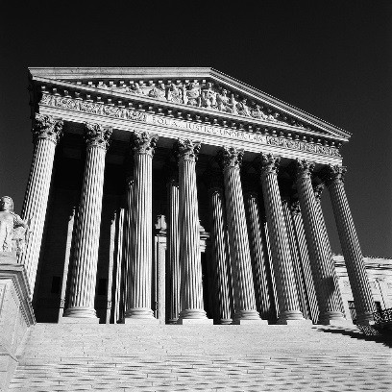
The Law
■
The United States has enacted
several laws that make it unlawful for employers to discriminate against employees, applicants, and clients.
Civil Rights Act of 1964
Age Discrimination Act of 1967
Americans with Disabilities Act of 1990

Slide 8
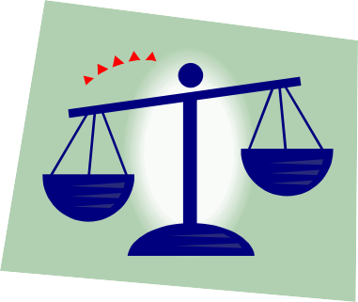
The Law
■
Because of these laws, employers must
base decisions (such as hiring, firing, job assignment, etc) solely on an employee’s ability to do the job.
■
Employers must make accommodations
(changes) for employees/customers with disabilities
■
Employers who discriminate are subject to
fines and lawsuits

Slide 9
Equal Opportunity Employer
An employer who agrees not to discriminate against any employee or job applicant
Publically makes statements that it does not discriminate:
It is the policy and commitment of [name of business] that it does not discriminate on the basis of race, age, color, sex, national origin, physical or mental disability, or religion.

Slide 10
Five Common Types of
Discrimination
Sex/Gender Discrimination
DisabilityDiscrimination
Age Discrimination
Racial/Ethnic Discrimination
Religious Discrimination
SDARR

Slide 11


Sex/Gender Discrimination
■ Discrimination based upon a person’s gender
■
Non-traditional occupations
Any occupation in which women or men comprise less then 25% of the workforce

Slide 12
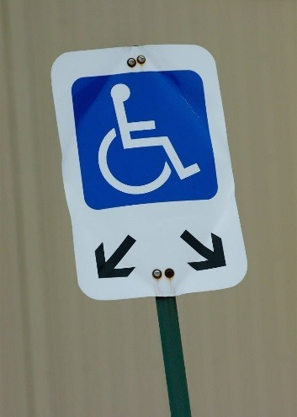
Disability Discrimination
■
Discrimination based on the fact that a
person has a disability
A disability is a long-lasting impairment that limits a major life activity
Can include mental or physical
■
To accommodate disabled employees,
employers may have to:
Restructure jobs
Alter equipment
Modify workstations

Slide 13
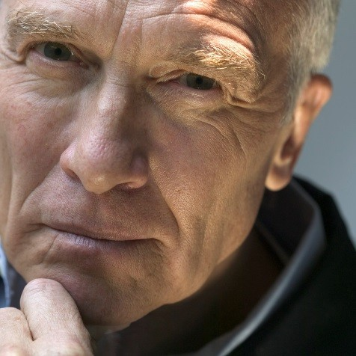
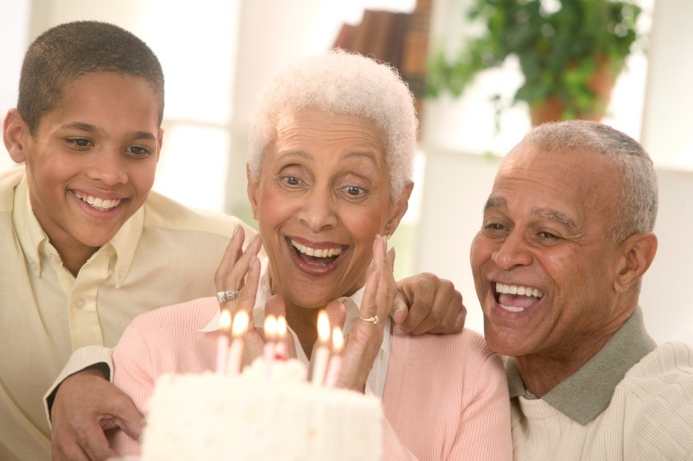
Age Discrimination
■ Employers may not discriminate based on a person’s age

Slide 14
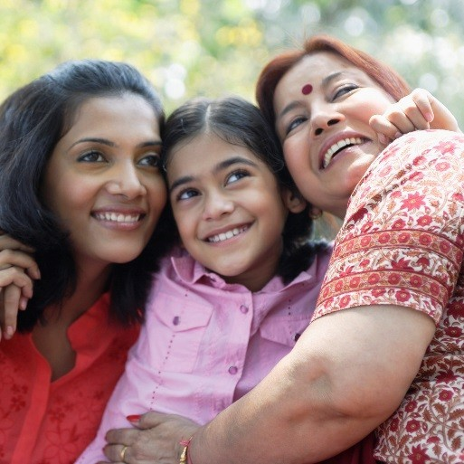
Racial/Ethnic Discrimination
Discrimination based on a person’s ethnicity or race
  Ethnicity means belonging to groups of people according to common racial, national, tribal, religious, linguistic, or cultural origin or background

Slide 15
Religious Discrimination
Employers may not discriminate based upon a person’s religion
Employers may need to make accommodations, such as time off for religious observances.

